Slide 1
Developer Training
Introduction to Spring Framework
What’s New in 3.0 & 3.1?
Notes:
This is the 1st class of Spring training series.
Today we are focusing on some basic of Spring Framework.
The next class is called Advanced Spring, which will focus on some of the advanced features of Spring.
If time is available today, we may take a look on some of the advanced features of Spring Framework family.

Slide 2

Who am I?
Andy Chan
Software Architect
Co-Author of Apress Pro Spring Integration
ISBN: 978-1-4302-3345-9
Twitter: iceycake
Skype: achan1218
Notes:
My name is Andy Chan
Some of you in the room or on the conference line may not know me
Software Architect, joins CityGrid the beginning of 2012
Co-Author Pro Spring Integration
If question with Spring, free to reach me via email, Skype, or Twitter

Slide 3
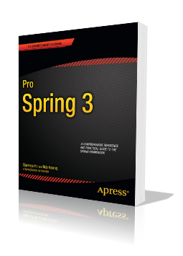
Pro Spring 3
Clarence Ho, Rob Harrop
Published April 18, 2012
ISBN: 978-1-4302-4107-2
Spring 3.0 & 3.1

Slide 4
What is Spring?
“Most Popular Application Development Framework for Enterprise Java.”
http://www.springsource.org
Notes:
How many people in this room are using Spring?
Anyone can tell me what is Spring?

Slide 5
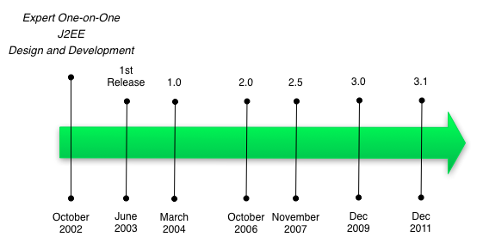
History
Notes:
Oct 2002, Rob Johnson released the framework along with his book “Expert One-on-One J2EE Design and Development”
June 2003, the framework was open-sourced and released under Apache 2.0 license
Version 1.0 was released in March 2004
The latest stable released was Spring 3.1 in December 2011

Slide 6
Spring Overview
Spring Framework
Spring Batch
Spring Integration
Spring Security
Spring Web Service
Spring Data
Spring Hadoop
Spring Mobile
Spring Social
Spring Web Flow
Spring BlazeDS
Spring Roo
Spring .NET
Spring Python
…
Notes:
Within 10 years, Spring has been expanded into 12 extensions
Even cover .NET and Python
Today, we are focusing on Spring Framework. If we have enough time, may talk about Spring Batch.
Next class, we will focus on Spring Batch, Spring Integration, Spring Data, Spring Hadoop, and Spring Web Service.

Slide 7
Spring Overview
Spring Framework
Spring Batch
Spring Integration
Spring Security
Spring Web Service
Spring Data
Spring Hadoop
Spring Mobile
Spring Social
Spring Web Flow
Spring BlazeDS
Spring Roo
Spring .NET
Spring Python
…
Notes:
Within 10 years, Spring has been expanded into 12 extensions
Even cover .NET and Python
Today, we are focusing on Spring Framework. If we have enough time, may talk about Spring Batch.
Next class, we will focus on Spring Batch, Spring Integration, Spring Data, Spring Hadoop, and Spring Web Service.

Slide 8
Spring Overview
Spring Framework
Spring Batch
Spring Integration
Spring Security
Spring Web Service
Spring Data
Spring Hadoop
Spring Mobile
Spring Social
Spring Web Flow
Spring BlazeDS
Spring Roo
Spring .NET
Spring Python
…
Notes:
Within 10 years, Spring has been expanded into 12 extensions
Even cover .NET and Python
Today, we are focusing on Spring Framework. If we have enough time, may talk about Spring Batch.
Next class, we will focus on Spring Batch, Spring Integration, Spring Data, Spring Hadoop, and Spring Web Service.

Slide 9
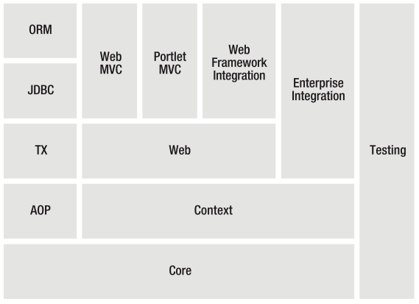
Spring Framework Overview

Slide 10
Spring Framework Overview
Foundation of Spring Extentions
Inversion of Control (IoC) and Containers
Spring Profile
Abstractions for JDBC, JPA, JTA, JMS, WS
MVC Framework
Notes:
Spring Framework is the foundation of all the Spring extensions.
Provides Inversion of Control Containers
Provides abstraction layer for all the J2EE related technologies: JDBC, JPA, JTA, JMS, Web Services
MVN Framework to build web application
Spring Test for Unit Testing

Slide 11
Inversion of Control (IoC)

Slide 12
Inversion of Control (IoC)
Java EE: EJB and EJB Container
Spring: POJO and POJO Container
Spring vs Java EE => Lightweight
Object Creation
Object Lookup
Object Life Cycle Management

Slide 13
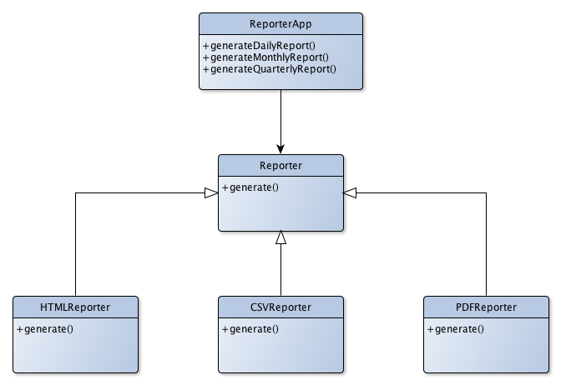
Inversion of Control (IoC)
Notes:
Let’s take a look at a simple OOP example:
UML Diagram
Reporter Interface: generate() method
3 concrete implementations: HTML, CSV, and PDF
Application has a reference to the Reporter Interface: Application does not know (and no need to know) what concrete implementation to use

Slide 14
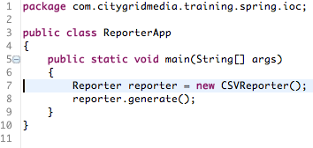
Inversion of Control (IoC)
Notes:
If the Reporter application wants to output the report in HTML format, we need to change the code and recompile.

Slide 15
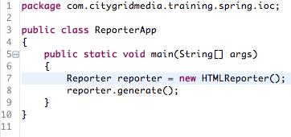
Inversion of Control (IoC)
Notes:
ReporterApp class is also tight integrated with the CSVReporter, HTMLReporter, and PDFReporter classes.

Slide 16
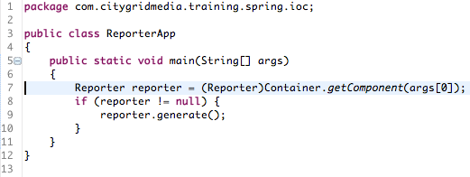
Inversion of Control (IoC)
Notes:
How about change to something like this? So we can passing in the type of Reporter?
ReporterApp can dynamically using different of implementation?
The concreted implementations are totally decoupled from the Application. The Application just know about the Interface contract.

Slide 17
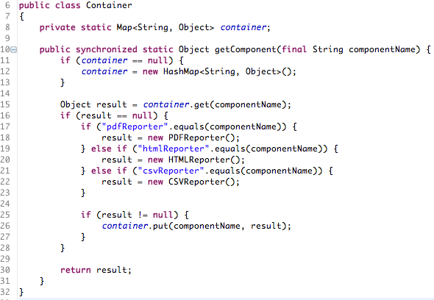
Inversion of Control (IoC)
Notes:
Container contains the name of the component and the reference of the instance.
Singleton

Slide 18
Spring IoC Container

Slide 19

Maven & Spring 2.5
Notes:
Prior to Spring 3.0, “1 size fits all”.

Slide 20
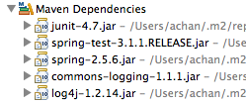
Maven & Spring 2.5

Slide 21

Maven & Spring 3.0/3.1
Notes:
Since Spring 3.0, we have to include the Spring modules that we would like to include into the project.

Slide 22
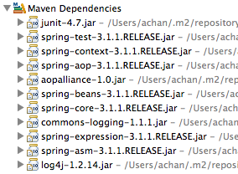
Maven & Spring 3.0/3.1

Slide 23
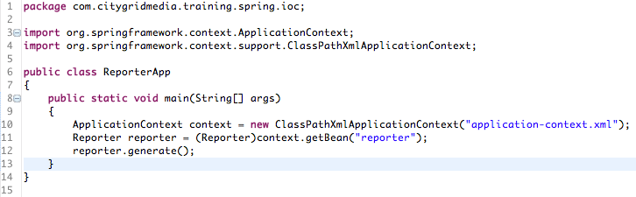
Spring IoC Container

Slide 24
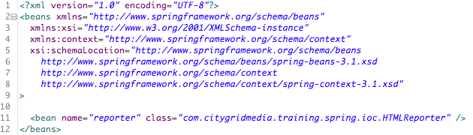
Spring IoC Container
Notes:
bean:name and bean:id are the same

Slide 25
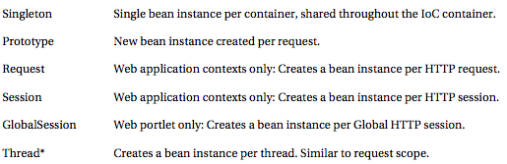
Bean Scopes
Notes:
* Thread scope is not registered by default, and requires registration with the CustomScopeConfigurer bean.

Slide 26
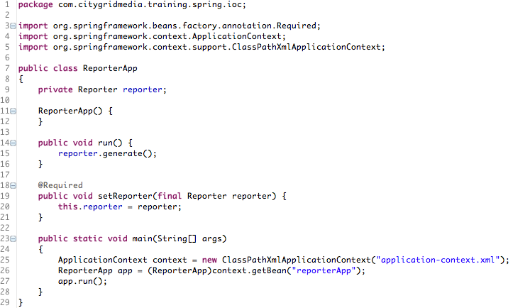
Spring IoC Container

Slide 27

Spring IoC Container

Slide 28
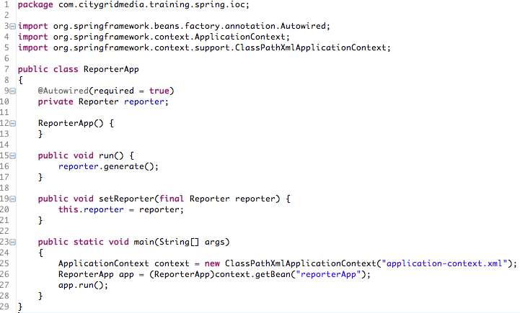
Auto Wiring

Slide 29

Auto Wiring (Cont’d)

Slide 30
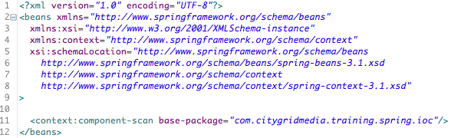
Auto Discovery
Notes:
Classes annotated as component stereotypes including (but not limited to)
@Configuration, @Component, @Repository, @Service, @Controller, or JSR-330 annotations, such as @Named
are inclusive to the auto-scan default filter.
Once auto-detected, components become Spring beans and are placed at the root of the application context.

Slide 31
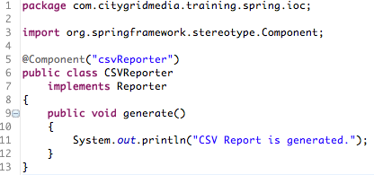
Auto Discovery (Cont’d)

Slide 32
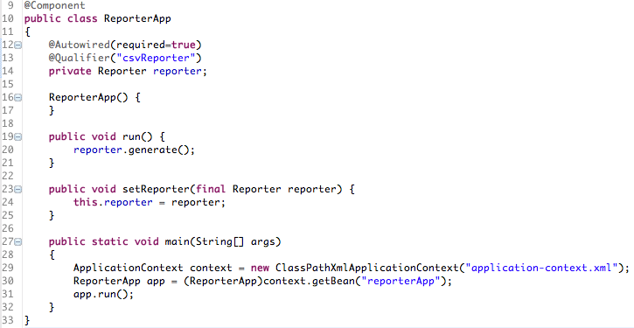
Auto Discovery (Cont’d)
Notes:
If not specific Qualifier, Spring will try to auto wire by type. However, we have 3 classes are implemented the Reporter interface and Spring will not know which one to use.

Slide 33
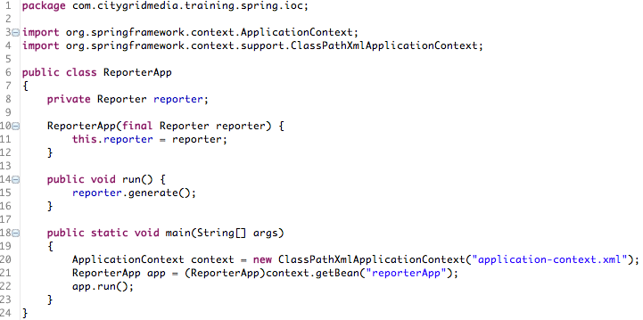
Constructor

Slide 34

Constructor (Cont’d)

Slide 35
XML Based Configuration
“XML Programming”
No Unit Testing
Error Message is not Helpful
Difficult to Catch Typo
Difficult to Troubleshoot

Slide 36
JavaConfig
Spring 3.0+
Answer to Google’s Guice
Annotation/Java Based DI
Same Level of Isolation as XML Configuration
Work with XML Configuration
Constructor is Useful again – Immutable
Unit Testing?

Slide 37

JavaConfig (Cont’d)
Notes:
In order to use JavaConfig, cglib is needed

Slide 38
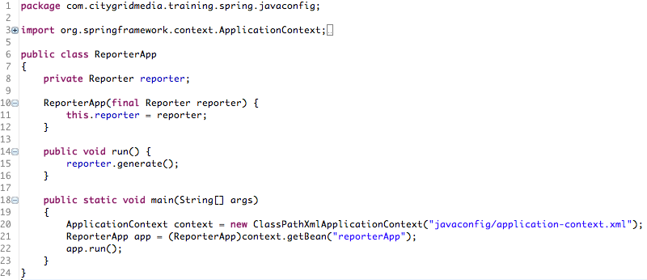
JavaConfig (Cont’d)

Slide 39
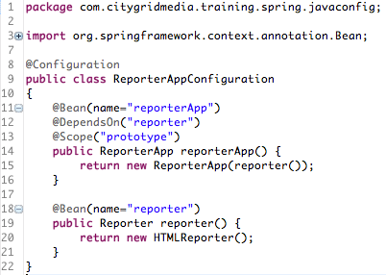
JavaConfig (Cont’d)

Slide 40
Property Management

Slide 41
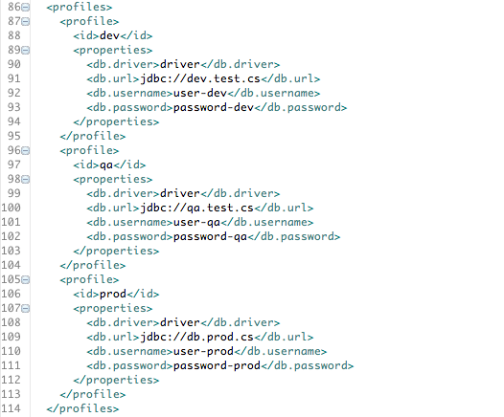
Maven Profile

Slide 42


Maven Profile (Cont’d)

Slide 43
Maven Profile (Cont’d)
Package Time Substitute
Security Concern
Exposing Username/Password
Rebuild if Configuration Changes

Slide 44
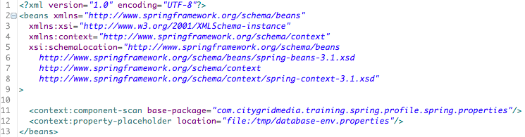
Spring & Properties

Slide 45
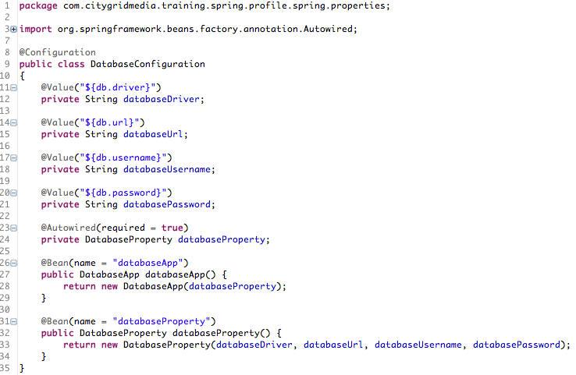

Spring & Properties (Cont’d)

Slide 46
Spring & Properties (Cont’d)
Managed Properties File Safely
No Rebuild if Configurations Need Change
Can Use JavaConfig & Auto Wiring

Slide 47
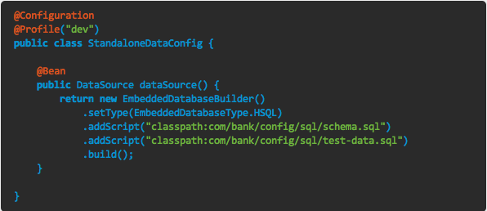
Spring Profile

Slide 48
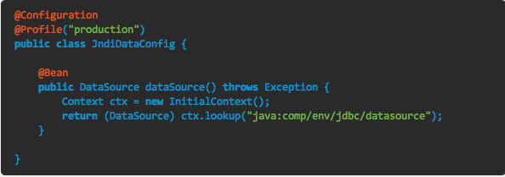
Spring Profile (Cont’d)

Slide 49
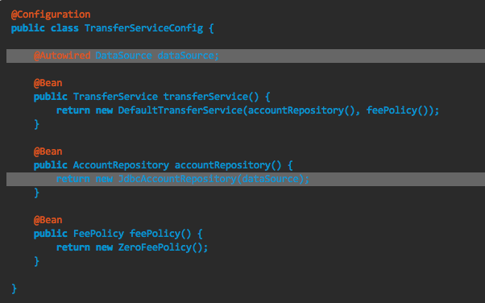
Spring Profile (Cont’d)

Slide 50
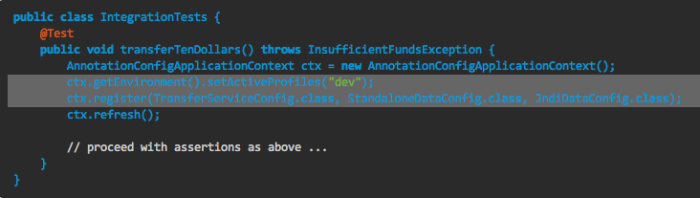
Spring Profile (Cont’d)

Slide 51
Spring Profile (Cont’d)
Different implementations based on Profile
Use Cases
Integration Testing vs Production Deployment
Embedding RDBMS vs Oracle
Embedding ActiveMQ vs Standalone ActiveMQ

Slide 52
Spring Framework

Slide 53
Data Access
Transaction Management
JDBC & DAO
DataSource
JDBCTemplate
ORM Support
Hibernate
Spring Data (JPA)

Slide 54
Integration Framework
Web Services
RestTemplate
WebServiceTemplate
Message Queue
JmsTemplate
AmqpTemplate (Requires Amqp Extension)
JMX

Slide 55
Task Management & Scheduling
Task Management
Task Executors
ConcurrentTaskExecutor
ThreadPoolTaskExecutor
TimerTaskExecutor
Scheduling
Quartz Based
Spring 3.0+
@Scheduled, @Async
Notes:
@Scheduled(fixedDelay=50000)
@Scheduled(cron=“*/5 * * * * MON-FRI”)

Slide 56
Dynamic Language Support
Not Java 6 Scripting Engine (javascript)
JRuby
Groovy
BeanShell
Spring Hadoop (Extension)
PIG
HIVE

Slide 57
Cache Abstraction
Spring 3.1+
@Cacheable(“cacheName”)
@Cacheable({“cache1”, “cache2”})
@Cacheable(value=“cache1”, key=“#id”)
Spring Expression Language (SpEL)
Cache Storage
ConcurrentMap
Ehcache
Notes:
Use SpEL declaration for key generation and value

Slide 58
Example Codes
https://github.com/iceycake/intro-spring

Slide 59



References
http://www.springsource.org/spring-framework

Slide 60
Questions

